Slide 1
Particle Swarm Optimization
By Rishabh Vikramkumar Jain
NUID : 001226719
Course : Program Structures and Algorithms

Slide 2
Problem Statement
Thermostat works by depending on random air current. The thermostat controls both the heating and cooling systems of homes and etc. The thermostat detects the temperature of the room and compares it to the desired temperature setting.
But most common cause of a thermostat reading the wrong temperature is that it is poorly located.
If your thermostat is in direct sunlight, near sources of drafts or not centrally located in your home, it will not give an accurate reading of your home’s temperature levels. And this in return will have erroneous temperature.

Slide 3
Approach
One of the solution can be to detach the sensors from thermostat and place it separately inside the room and let the sensors communicate with thermostat.
The process starts by thermostat sensing the desired temperature of the region and later on that target position will be verified by the means of communication between sensors and later on, with thermostat.

Slide 4
The basic idea
The particles in the swarm co-operate. They exchange information about what they’ve discovered in the places they have visited
The co-operation is very simple. In basic PSO it is like this:
A particle has a neighborhood associated with it.
A particle knows the finesses of those in its neighborhood, and uses the position of the one with best fitness.
This position is simply used to adjust the particle’s velocity

Slide 5
Algorithm: the basic idea (cont.)
Each particle is searching for the optimum.
Each particle is moving and hence has a velocity.
Each particle remembers the position it was in where it had its best result so far (its personal best)
But this would not be much good on its own; particles need help in figuring out where to search.

Slide 6
What Particle does ?
In each time step, a particle has to move to a new position. It does this by adjusting its velocity.
The adjustment is essentially this:
The current velocity PLUS
A weighted random portion in the direction of its personal best PLUS
A weighted random portion in the direction of the neighborhood best.
Having worked out a new velocity, its position is simply its old position plus the new velocity.

Slide 7
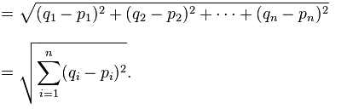
Equations
Equation (a)
Velocity = (W * Velocity) + C1 * ( R1 * ( Local_Best_Coordinate – Current_Coordinate )) + C2 * ( R2 * (Global_Best_Coordinate –Current_Coordinate))
Equation (b)
Next_Coordinate = Current_Coordinate + Velocity;
Equation (c)
Euclidean Distance

Slide 8
Algorithm
For each Initialize sensor END Do For each sensor Calculate fitness value according equation (c) If the fitness value is better than its peronal best
set current value as the new pBest End Choose the sensor with the best fitness value of all as gBest For each sensor Calculate sensor velocity according equation (a) Update sensor position according equation (b) End While maximum iterations or minimum error criteria is not attained

Slide 9
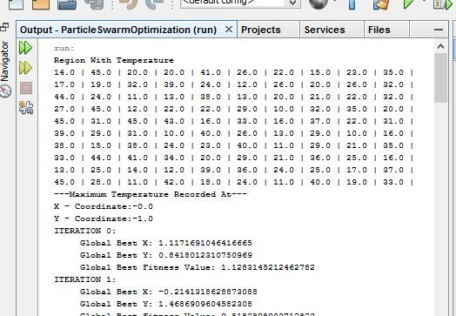
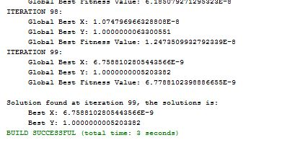
Console Output
Start of the program: shows the Coordinate of highest temperature recorded.
Which is then target for all the sensors for verification.
End of the program: shows the solution at target position (0,1)
i.e. all the particles nearly converge at that point

Slide 10

Visualization
Sensors Trying to converge towards the target based on fitness value and velocity.

Slide 11
Visualization
Iteration v/s Global Fitness Value Trend:-

Slide 12
Visualization
Scatter Plot of X-Y of Global Fitness Values

Slide 13
Conclusion
The sensors present in the swarm were able to communicate with each other and were able to find the desired room temperature.
This temperature is then sent to the thermostat for verification, on basis of which thermostat can maintain the temperature with no errors.

Slide 14
References
Design and Experimental Evaluation of PSO and PID Controller based Wireless Room Heating System. International Journal of Computer Applications (0975 – 8887) Volume 107 – No 5, December 2014
Link: https://pdfs.semanticscholar.org/3517/5bef8ef8a9285065f4fbd70eb62351d1abc0.pdf
Particle Swarm Optimization (PSO) by Gandhi Manalu.
Wikipedia Particle swarm optimization: https://en.wikipedia.org/wiki/Particle_swarm_optimization
http://www.swarmintelligence.org/
MathWork : https://www.mathworks.com/help/gads/particle-swarm-optimization-algorithm.html?requestedDomain=www.mathworks.com
References:-
Design and Experimental Evaluation of PSO and PID Controller based Wireless Room Heating System. International Journal of Computer Applications (0975 – 8887) Volume 107 – No 5, December 2014
Link: https://pdfs.semanticscholar.org/3517/5bef8ef8a9285065f4fbd70eb62351d1abc0.pdf
Particle Swarm Optimization (PSO) by Gandhi Manalu.
Wikipedia Particle swarm optimization: https://en.wikipedia.org/wiki/Particle_swarm_optimization
http://www.swarmintelligence.org/
MathWork : https://www.mathworks.com/help/gads/particle-swarm-optimization-algorithm.html?requestedDomain=www.mathworks.com

